Slide 1

Intro to the Anchore Harbor Scanner Adapter
Zach Hill, Principal Architect
Dec. 2019

Slide 2
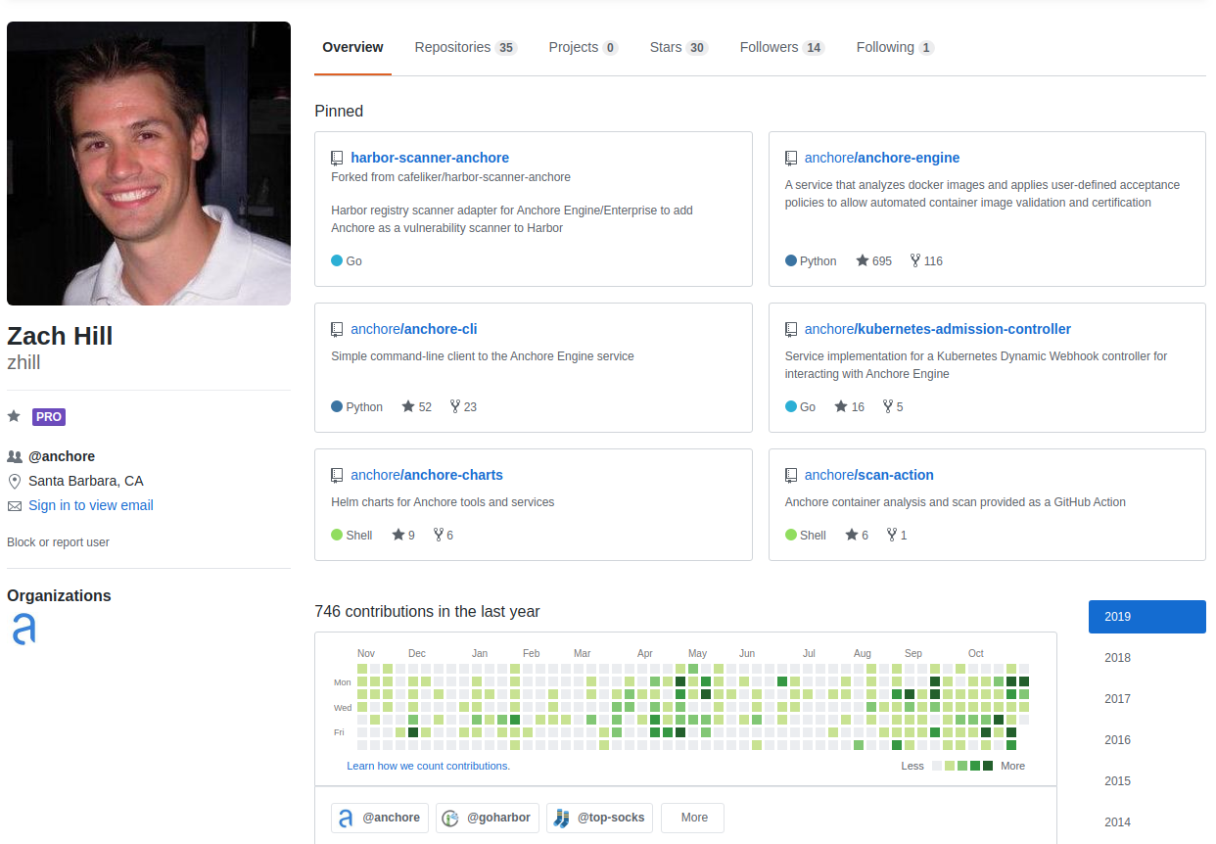
Introductions
Principal Architect
Co-authored first release
Helm Chart Maintainer
Integrations
Harbor
Kubernetes

Slide 3
Anchore Overview

Slide 4







Our Mission
To enable secure container-based workflows without compromising velocity
Full container transparency for developers
Audit and response for security teams
CI/CD scanning
for DevOps teams
Compliance enforcement for operations teams

Slide 5











Anchore Engine Key Capabilities
Image Analysis
Security Scanning
Policy Engine
Operating system packages
OS vendor-disclosed vulnerabilities
Docker CIS, DoD policy bundles
Language files
Bespoke policies with 100s of rules
Binary files
CVSS v3 support
Library vulnerabilities
Dockerfile metadata
Best practice validation
ISV application
vulnerabilities
Whitelist/Blacklisting
Credential enforcement

Slide 6



What Makes Anchore Unique?
Deep image inspection
Anchore Engine is the only scanning system that thoroughly analyzes images to find issues with OS packages, libraries, licenses, binaries, credentials, secrets, and metadata.
Rich policy and compliance language
Out of the box policies allow you to conform to regulatory standards or create detailed, custom policies that trigger alerts back to your development team.
Automation-centric with 100% API coverage
Anchore Enterprise fits into your CI/CD workflows and automated security processes because every feature is available through fully-documented APIs.
Based on 100% open source Anchore Engine
Anchore Engine attracts a vibrant ecosystem that drives rapid integration with Kubernetes, Helm, Harbor and other cloud native software.

Slide 7
Policy Richness Example
Identify Images with Vulnerabilities where:
Severity >= High (or use CVSSv3 Score) AND
Image has been vulnerable > 30 days AND
Fix available > 10 days AND
CVSSv3 Exploitability Score > 7.0
SSH keys found
AWS creds found

Slide 8
Scanning in Harbor

Slide 9
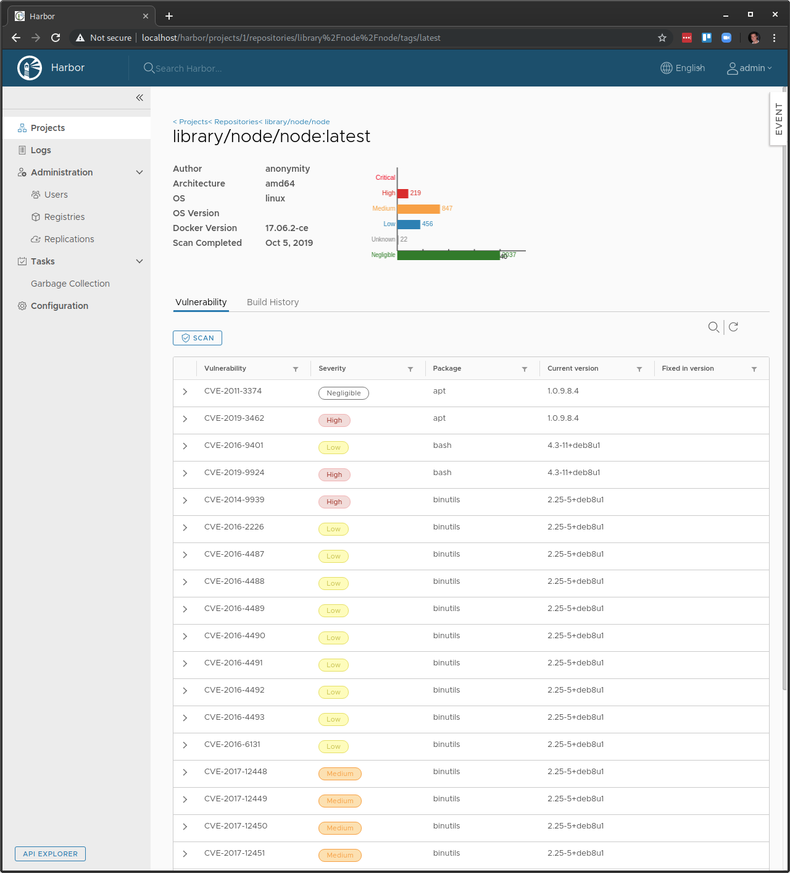
Harbor Integration
Visualize scan results directly in Harbor
Block image pulls
Schedule scans/updates

Slide 10
Anchore Scanner Adapter

Slide 11
Overview
Acts as API translation layer between Harbor and Anchore
Supports both OSS Anchore Engine and Anchore Enterprise
Stateless & simple to deploy

Slide 12
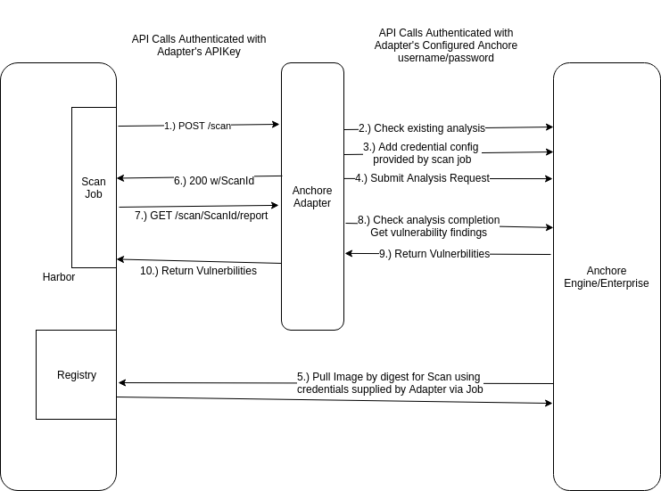
High-Level Flow

Slide 13
Getting Started
Install Harbor… (for another time!)
Install Anchore…
helm install --name anchore stable/anchore-engine
Install adapter:
git clone https://github.com/anchore/harbor-scanner-adapter
kubectl create secret ...
kubectl apply -f harbor-scanner-adapter/k8s/harbor-adapter-anchore.yaml
Config in Harbor...

Slide 14
Features of Note
Authentication of API calls supported
Filter vendor ignored/no-fix vulns (e.g. Debian’s No-DSA Flag)
Vulnerability Scans for OS packages and application packages

Slide 15
Roadmap and Collaboration!
Current version is beta, GA end-of-week (Dec 6th)
Future version features:
Policy integration
More report type support
Ideas? Let me know!
Webinar on Dec 11th with more detail on workflows etc

Slide 16
Feedback
Scanner Adapter Project: https://github.com/anchore/harbor-scanner-adapter
Anchore Links:
Anchore Engine https://github.com/anchore/anchore-engine
Anchore CLI https://github.com/anchore/anchore-cli
Docs https://docs.anchore.com

Slide 17




docs.anchore.com
zach@anchore.com
github.com/anchore
@zedjayhill

